Slide 1


PRESENTED BY:
MAY 15, 2026
GWEN PIPER DIEDE
Social Media Strategy
and Outbound Growth

Slide 2
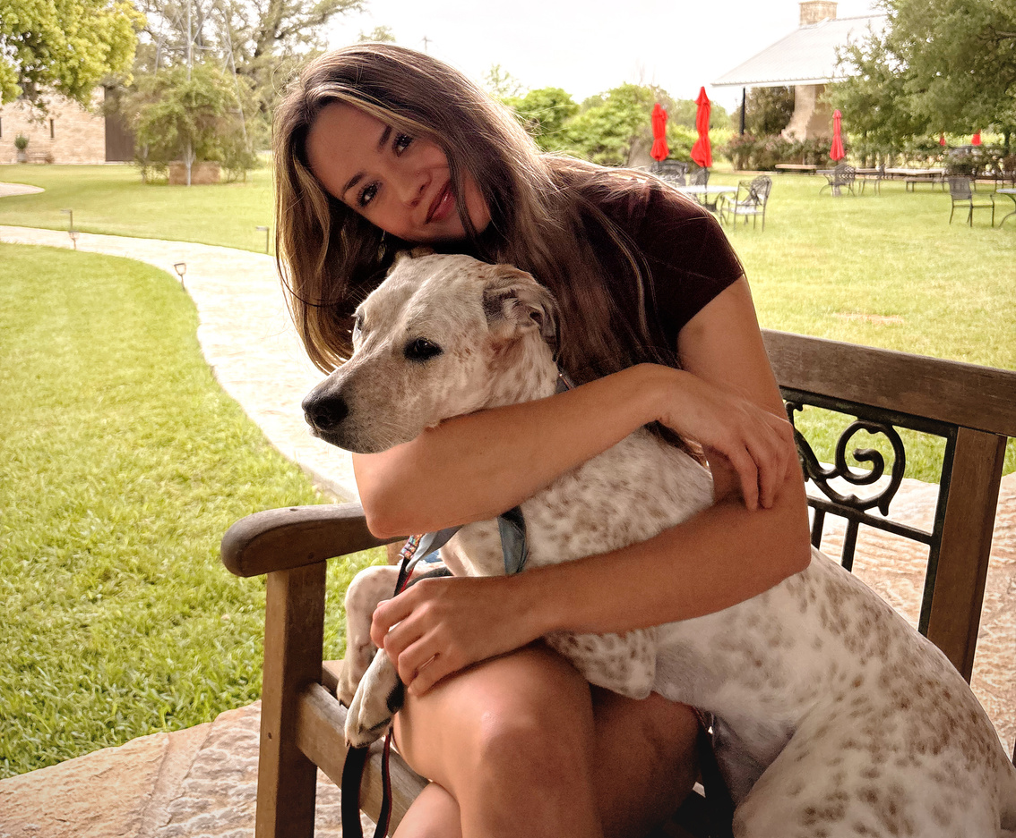
HAZELPIPER CREATIVE
DIRECT CARE ALLIANCE
May 2026
Who I Am
I am a creative strategist and content operator with a background spanning hospitality, event design, lifestyle branding, and B2B healthcare content.
I built HazelPiper Creative because I kept seeing the same problem: organizations with something genuinely worth saying, spending money on content that sounded like everyone else.
My work sits at the intersection of editorial strategy and operational structure — where atmosphere, pacing, and intentional presentation drive results.
EDITORIAL SENSIBILITY
Content that feels considered, not assembled. Every post earns attention.
OPERATIONAL STRUCTURE
Systems, calendars, and workflows built for consistent, reliable output week after week.
HEALTHCARE FLUENCY
I speak the language: brokers, TPAs, direct care, and mid-market employers.

Slide 3
HAZELPIPER CREATIVE
DIRECT CARE ALLIANCE
May 2026
THE OPPORTUNITY
Trust is built before the call.
  Direct contracting and direct care models are moving from fringe to mainstream. Brokers and TPAs don't respond to cold outreach — they respond to consistent presence and credible perspective demonstrated over time.
  A content-first strategy creates the conditions for every sales conversation to be warmer before it starts.
  When a broker has read ten posts from Direct Care Alliance before getting on a call with David, the dynamic changes completely. They are not evaluating — they are verifying what they already believe.

Slide 4

HAZELPIPER CREATIVE
DIRECT CARE ALLIANCE
May 2026
CLOSING THE GAP
Between Presence & Impact
The healthcare content landscape is crowded with rushed, generic work. DCA has a genuinely differentiated message — and right now it's not consistently reaching the brokers and TPAs who need to hear it.
Content that feels considered earns more attention than content that looks like everything else. Consistent presence builds trust before the first conversation. Structured outreach closes faster.
HazelPiper Creative builds the infrastructure to make all three happen — without burdening your internal team.

Slide 5
HAZELPIPER CREATIVE
DIRECT CARE ALLIANCE
May 2026
SERVICES FOR
Direct Care Alliance
SOCIAL MEDIA & CONTENT
  LinkedIn · X/Twitter 5 to 7 posts per week, every week without exception.
  Platform-specific strategy, scheduling, and engagement monitoring built around the DCA brand voice and enrollment goals.
LINKEDIN & OUTBOUND
  Ghostwritten thought leadership posts for David Balat.
  Apollo IO outreach sequences targeting TPAs, brokers, and mid-market employers.
  Email cadence management and lead tracking.

Slide 6

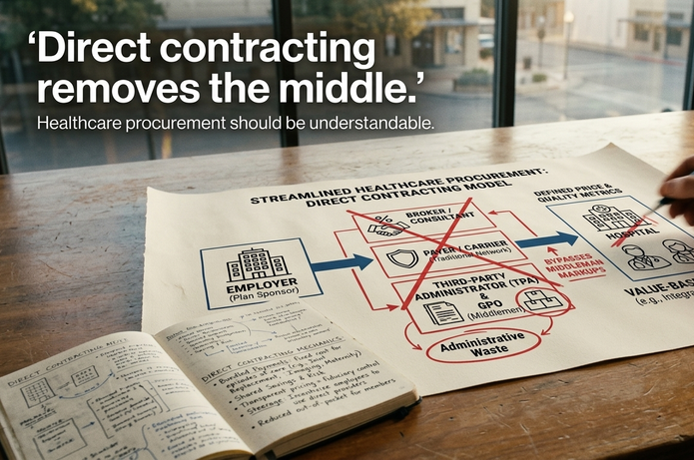

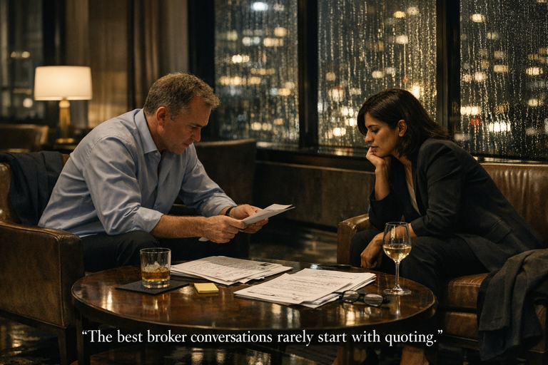
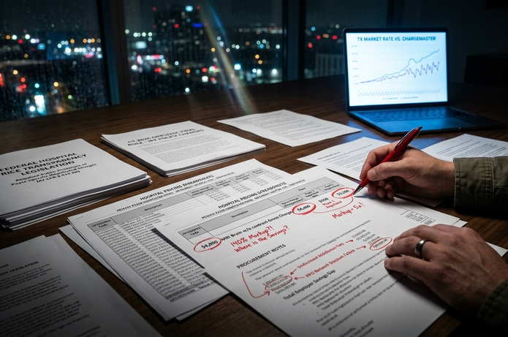
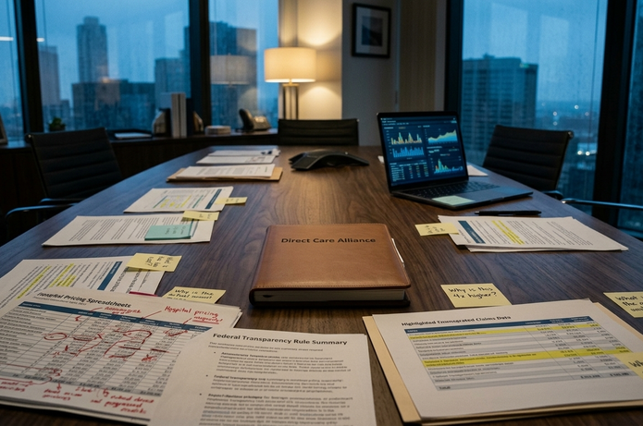
HAZELPIPER CREATIVE
DIRECT CARE ALLIANCE
May 2026
Every content pillar anchors DCA's social presence to a consistent strategic message — educating brokers, building David's authority, and driving enrollment conversations across every platform.
Content Pillars
BROKER TRUST BUILDING
ENROLLMENT OUTCOMES
DIRECT CARE EDUCATION

Slide 7
HAZELPIPER CREATIVE
DIRECT CARE ALLIANCE
May 2026
STRUCTURE FIRST.
Then Scale.
DISCOVER
STRATEGIZE & CREATE
DISTRIBUTE & OPTIMIZE
Brand audit, voice assessment, platform review, and goals alignment. We establish exactly where DCA stands before we build anything.
Content calendar architecture, messaging framework, LinkedIn strategy, and Apollo IO sequence setup — built specifically for DCA's audience of brokers and TPAs.
Weekly publishing, outbound sequences, LinkedIn engagement, monthly analytics reporting, and strategic recalibration. Consistent presence, every week.

Slide 8
HAZELPIPER CREATIVE
DIRECT CARE ALLIANCE
MAY 2026
WHAT I DELIVER
for DCA
  5 to 7 social posts per week across LinkedIn, X, and Meta
  Monthly content calendar and editorial direction
  Platform-specific copy and creative guidance
  Engagement monitoring and community management
  Monthly analytics report and recalibration session
  Ghostwritten LinkedIn thought leadership for David Balat
  Apollo IO prospecting sequences for broker and TPA outreach
  Email cadence management and sequence optimization
  Warm outreach coordination and lead tracking
  Monthly outbound performance reporting

Slide 9
HAZELPIPER CREATIVE
DIRECT CARE ALLIANCE
May 2026
HOW WE WORK
Together
Every engagement begins with a structured brand intake process. I audit your current content, interview your leadership, and map your audience before a single post is written.
From there, we build systems — content calendars, approval workflows, scheduling cadences — designed to run smoothly and scale cleanly. You get consistent, intentional presence without constant oversight.

Slide 10

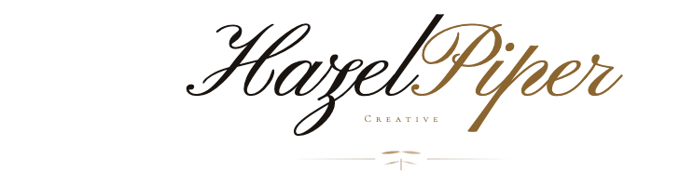

HAZELPIPER CREATIVE
DIRECT CARE ALLIANCE
May 2026
ABOUT
ABOUT
Me
  HazelPiper Creative is a boutique content and growth studio combining editorial sensibility with operational discipline to produce elevated content for healthcare, hospitality, and lifestyle brands.
  Content operator and editorial thinker. Specializing in LinkedIn thought leadership, social media strategy, and Apollo IO outbound growth systems.
Gwen Piper Diede
Creative strategist with a background in hospitality, event design, and B2B healthcare content. Founder of HazelPiper Creative.
  Structured systems. Intentional creative. Built for organizations with something genuinely worth saying — and the discipline to say it consistently.

Slide 11
DIRECT CARE ALLIANCE
May 2026
Engagement Structure
CORE RETAINER
  5 to 7 posts per week across platforms
  LinkedIn thought leadership ghostwriting
  Monthly content calendar
  Engagement monitoring
  Analytics reporting
GROWTH ADD-ON
  Apollo IO sequence build
  Broker outreach cadences ·
  Lead tracking setup
  Warm outreach coordination
All engagements begin with a 2-week brand intake. First content calendar delivered within 14 days of signature.

Slide 12



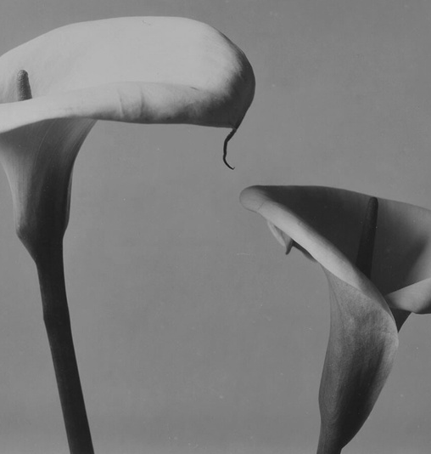
HAZELPIPER CREATIVE
DIRECT CARE ALLIANCE
May 2026
MY APPROACH
To DCA
We help brands build clear, structured, intentional visibility through strategic content, messaging systems, and outbound growth infrastructure.
How you present an idea is part of the idea. In a space crowded with rushed, generic healthcare marketing, editorial quality signals the same qualities Direct Care Alliance wants to be known for: intelligence, integrity, and operational clarity.

Slide 13

HAZELPIPER CREATIVE
DIRECT CARE ALLIANCE
May 2026
Let's Make This Happen.
512-787-7922
gwendiede@gmail.com
@hazelpipercreative
hazelpipercreative.com

