Slide 1
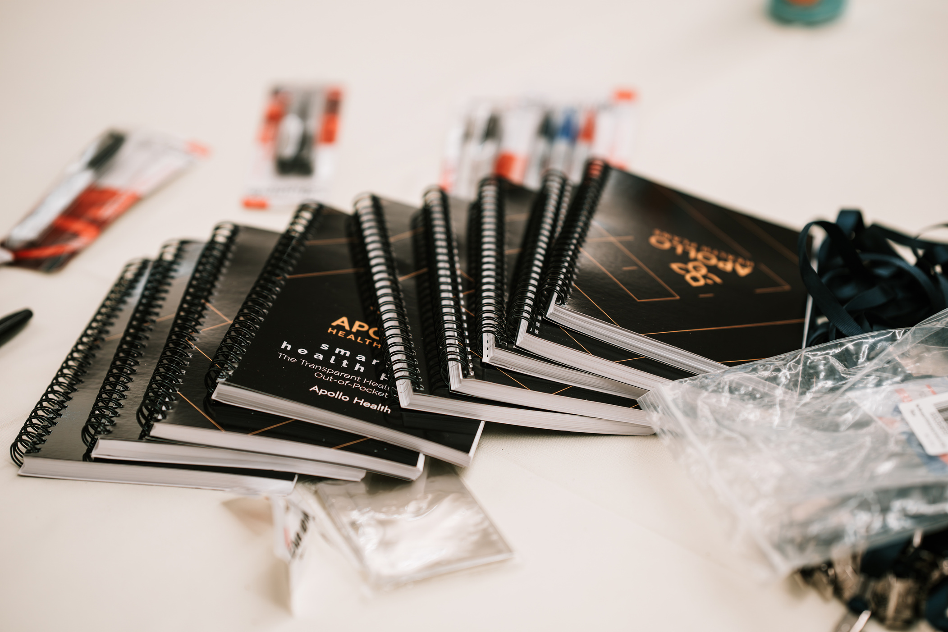



ZENITH RISK STRATEGIES CONFERENCE SUMMER SERIES
BUCA VS BLUEBONNETS
04.23.2026 | The Statler

Slide 2
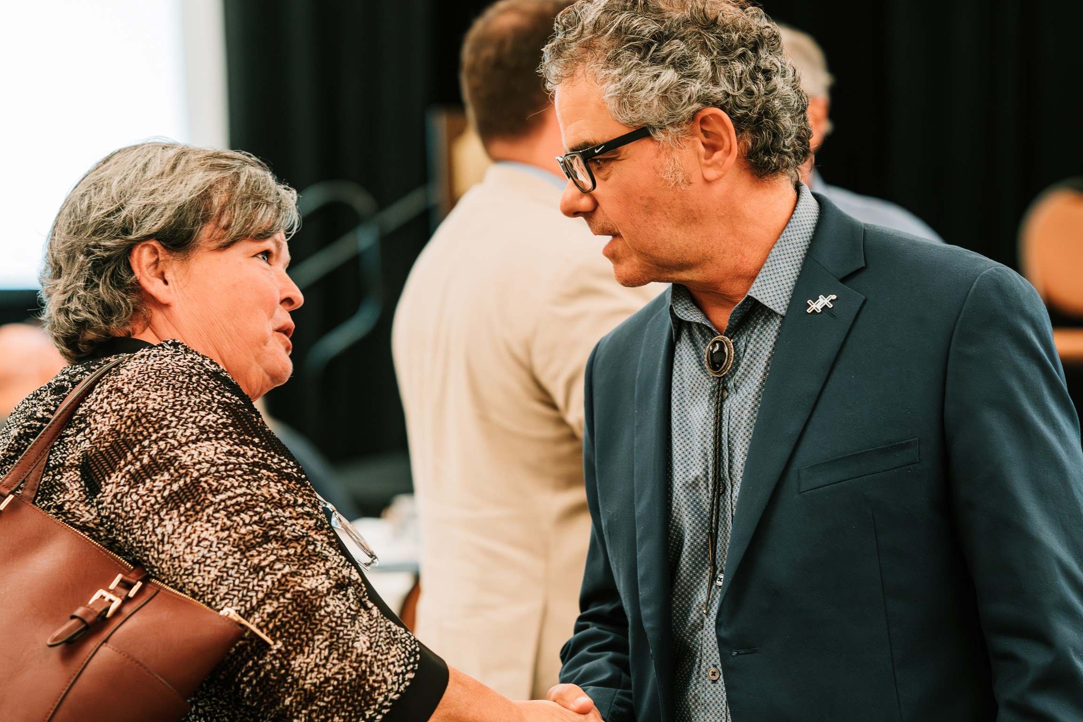
WHY DALLAS?
Dallas represents scale.
  More brokers.
  Faster decision cycles.
  Higher carrier density.
  More exposure to default BUCA models.
    This is not a foundation market.
    This is a pressure market.

Slide 3
  DOWNTOWN DALLAS LOCATION
  EXECUTIVE FEEL
  BUILT IN EVENT SPCACE
  DISCOUNTED HOUSE AV
  NO RESORT FEE
  LOW ROOM GROUP RATE
WHY THE STATLER

Slide 4
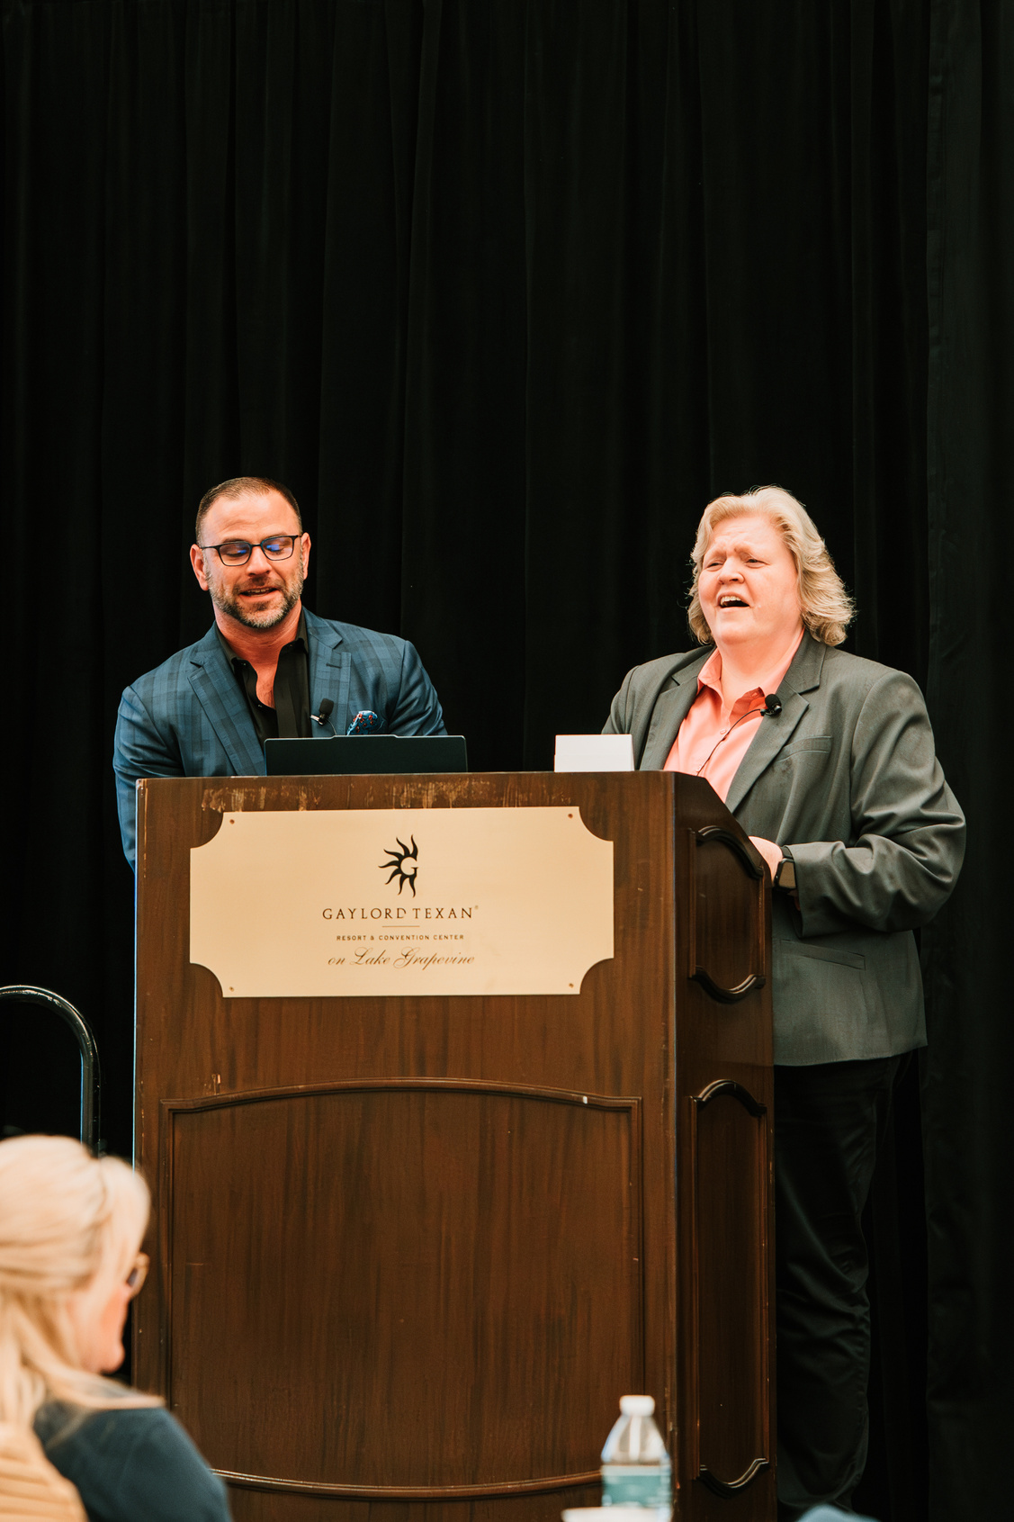
The Dallas summit tests one question:
Does disciplined healthcare design hold under growth?
Zenith’s thesis:
Cost containment is not achieved through speed. It is achieved through structure built for the climate it operates in.
STRATEGIC PURPOSE

Slide 5
ROLE IN 2026 SERIES
OUR THREE CONFERENCES WITH PURPOSE
GEORGIA/HILTON HEAD
MARKET OPPORTUNITY
DALLAS
INDUSTRY TREND
DENVER
Foundation and Relationship Capital
Discipline at Altitude
scale & pressure
Environmentally friendly
Sustainable Products

Slide 6
  Tracy Creger
2026
DALLAS
SPEAKER LINEUP
  Jared
  Jason Roll
  Trevor
  Donte
  Thomas Wagner

Slide 7
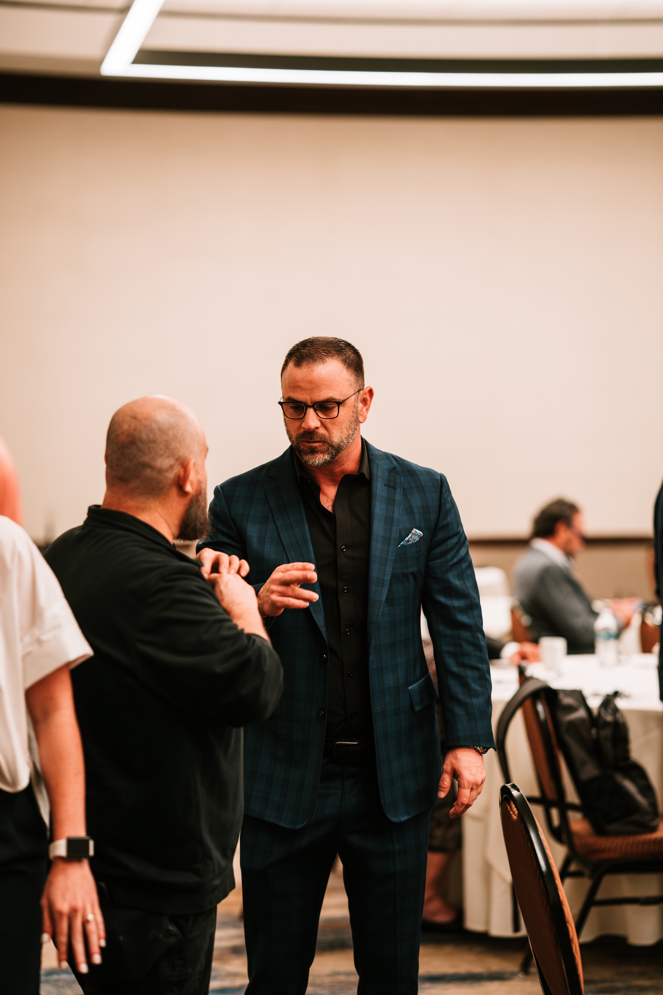
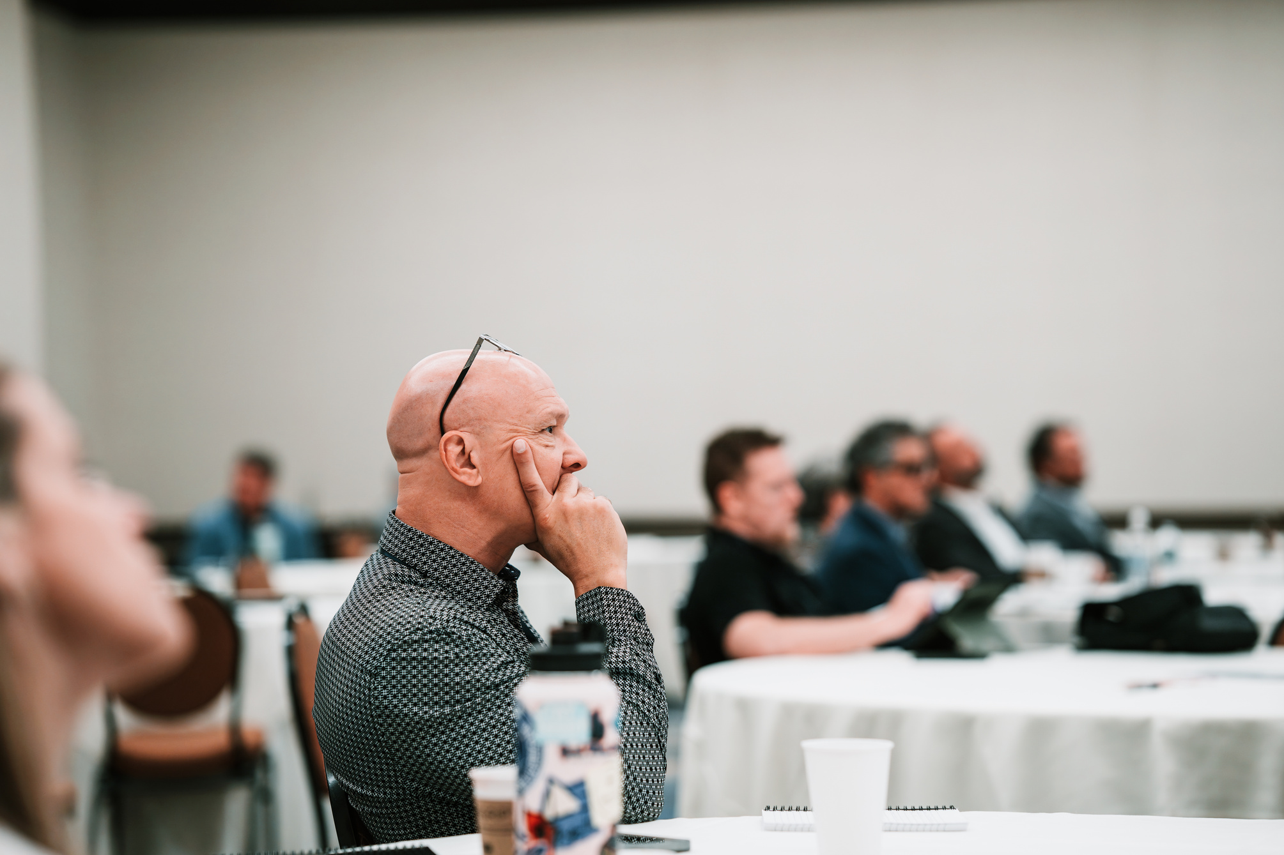
IDEAL ROOM SIZE:
35-50 decision-makers & brokers
TARGET AUDIENCE
  Regional & National Brokers
  TPA’s
  Employer CFOs (50-500 lives)
  Growth-stage employers
  Advisors navigating volatility

Slide 8

THE AGENDA
10:00 AM
Initial Design and Development
PHASE 2
Product Testing and User Feedback
PHASE 3
Refinement and Preparation for Launch
MARKETING STRATEGY
SEO, advertising, social media, Influencers
DISTRIBUTION CHANNELS
E-commerce, physical stores, distributors
PRODUCT DEVELOPMENT :

Slide 9

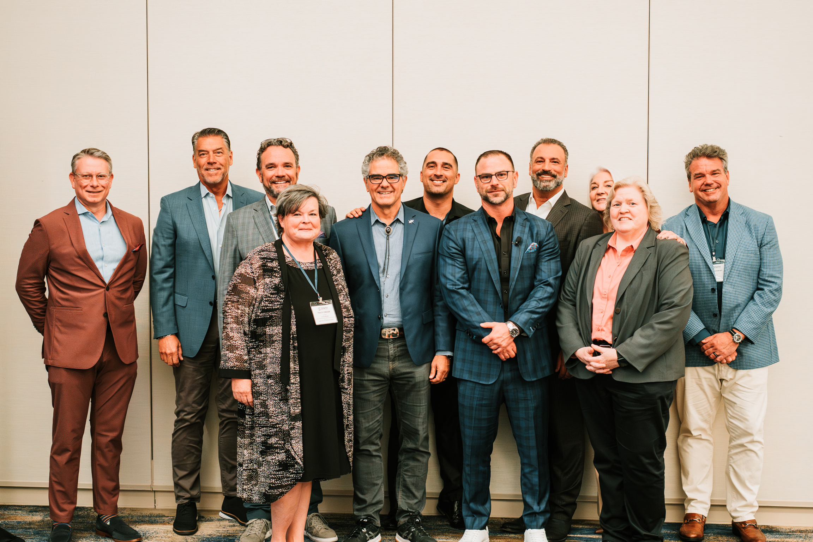

EMBASSY ROOM RENTAL
HOTEL ROOM
$500
$279
F&B MINIMUM
MARKETING & EXECUTION
$5000
(27% service charge)
(8.24% sales tax)
=$6,900
$1000
TOTAL SPLIT 6 WAYS
AV PACKAGE
$1,600
$700
THE COST

Slide 10
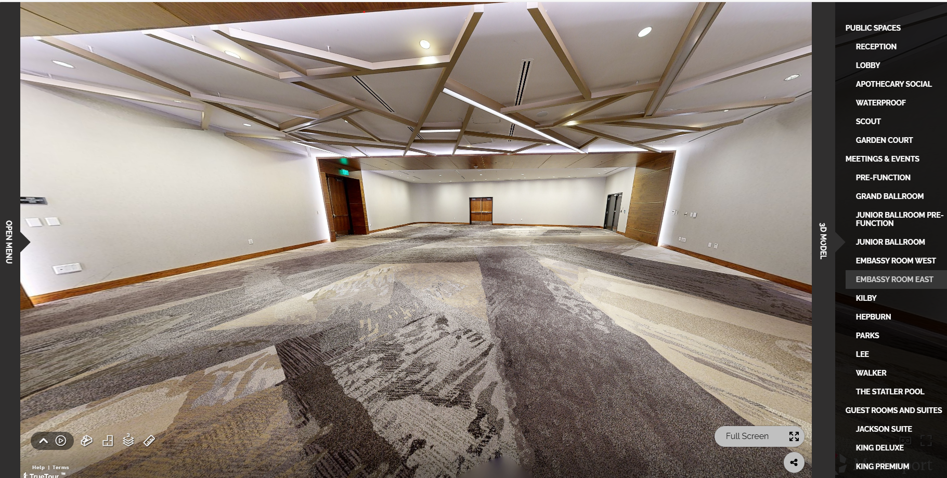
WE EVALUATE COST ON:
  Cost
  Executive feel
  Accessibility
  Brand Alignment
  F&B Minimum Risk
THE STATLER’S STRENGTHS:
  low room rental
  manageable minimum
  downtown access
TO NEGOTIATE:
  27% service fee
  parking cost
DECISON FRAMEWORK

Slide 11
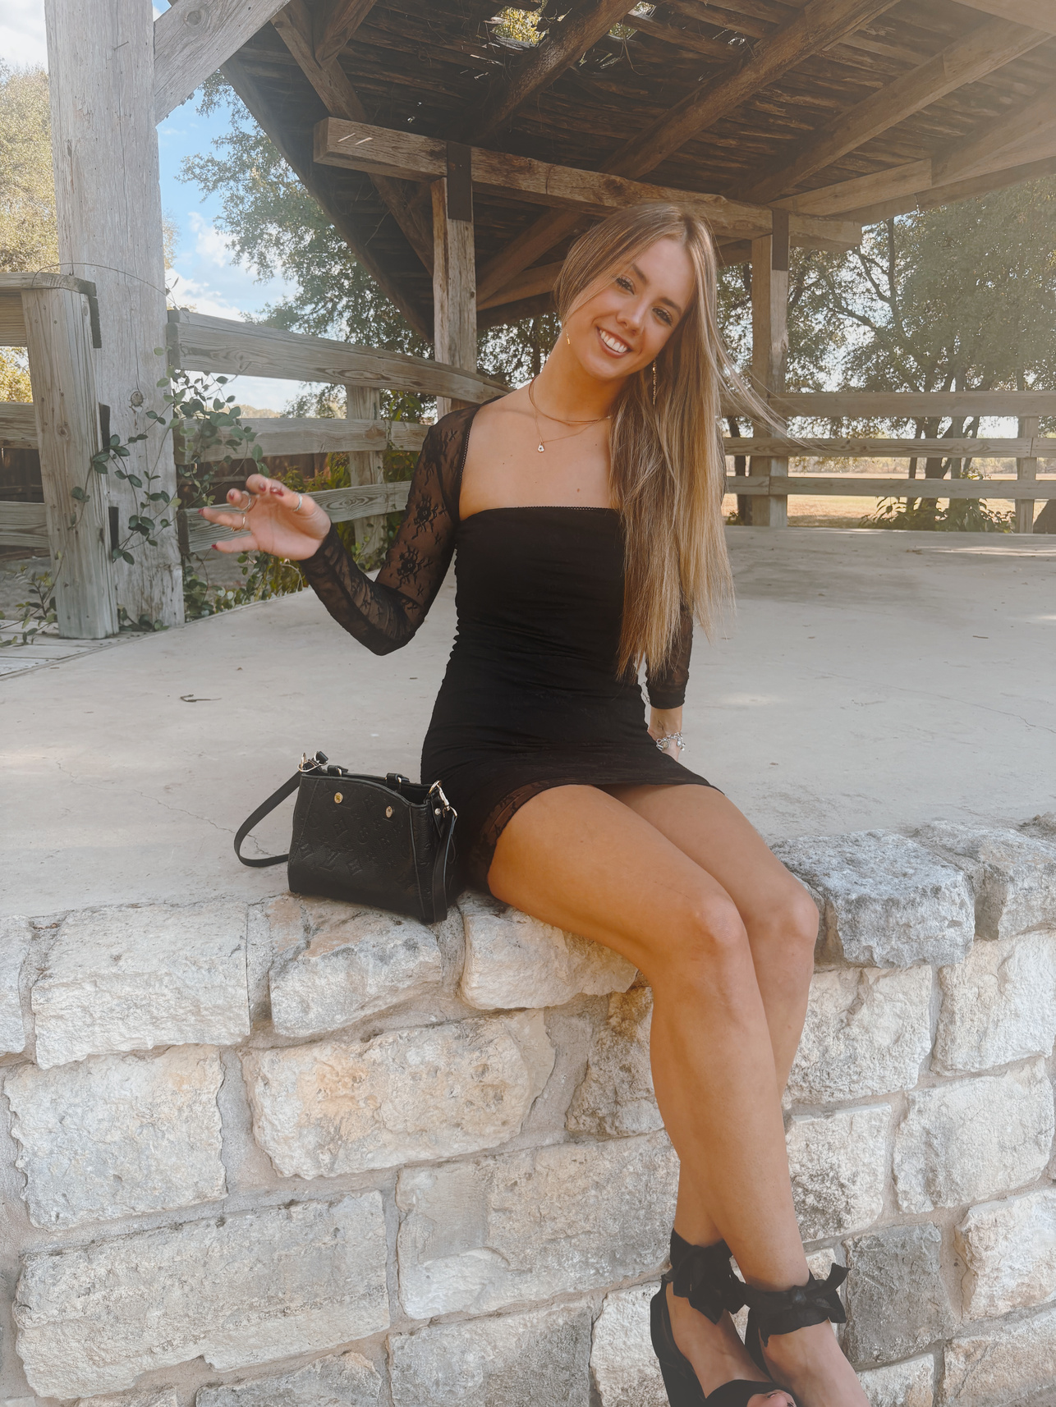

EVENT DIRECTOR | MARKETING | OPERATIONS
Gwen Diede
  Venue negotiation
  Budget control
  Speaker coordination
  Agenda execution
  Run of Show
  Onsite command
  Social media
  speaker liaison
  registration
  event timekeeping
  AV coordination
  speaker management
  LinkedIn strategy
  direct broker outreach
  registration tracker
  post-event recap
EVENT TEAM
CEO & FOUNDER | LEAD SPEAKER
Thomas Wagner
  strategic framing
  opening & closing
  panel moderation
  relationship development
THE STATLER EVENT MANAGER
Maya Puna

Slide 12
That is the explanation of the project that will be worked on, this project has great potential to meet the needs of the growing market and achieve significant profits in a short time.
CONCLUSION

Slide 13
THANK YOU
+ 123-456-7890
www.reallygreatsite.com
123 Anywhere St., Anycity

